Slide 1



Smart Health Prediction Using Machine Learning Shivapriya Pillalamarri Naragani Bharghavi Supraja Lakshmi Devi Ravula Nagaraj
ICIASC-2023: INTERNATIONAL CONFERENCE ON INTELLIGENT AND SMART COMPUTATION
Shivapriya Pillalamarri
Graduate
Paper ID: 440

Slide 2
Table of Content
Abstract
Introduction
Related Work
Proposed Work
Results
Conclusion
References

Slide 3
Abstract
Now-a-days, Health care industries are literally playing a major role in curing the diseases that are suffering the people. And this will be one kind of help to health care industries. In present days, people are facing lot of issues related to their health due to their life style and their livelihood. Due to their busy schedule in their lives, people are not at all taking care of their health. They are not having the time to consult doctors and know what they are going through and it may lead to severe risk for them. So, People should be aware of what they are going through at early stage will reduce the high risk. In our proposed system we used logistic regression, Random Forest Classifier and Decision tree classifier in prediction of the disease. Disease Prediction is a supervised model that is used for prediction of diseases from the symptoms or the information provides by the user. This proposed system will process the symptoms entered by the user and provide the predicted disease as an output.

Slide 4
INTRODUCTION
Machine learning (ML) is used across the globe. They play a Crucial role in the health care Industries. It is the scientific study of various algorithms and statistical models which computer uses to perform a specific task. ML model learns from the data and experience. The ML algorithm has two phases: Training & Testing . This model will predict the disease from information provided by the user. ML is also used by the healthcare industry to bring improvement in their techniques so that they can provide better quality of service to their patients . The Disease prediction system predicts diseases by analyzing the symptoms of user provided to the system. The system will process the symptoms which are given by the user and gives the predicted disease as an output. Naive Bayes classifier, which is a supervised ML technique is employed for Disease prediction. With the help of this algorithm, we can calculate the probability of the disease.

Slide 5
Related Work
In [4], a novel ML-based algorithm was developed by the authors to enhance the accuracy of cardiovascular disease (CVD) prediction compared to the Framingham risk score (FRS). This approach utilized a quantum neural network to identify and learn patterns related to CVD. The experiment involved data from 689 individuals with CVD symptoms, along with a validation dataset collected from the Framingham study. The proposed system achieved a remarkable CVD risk prediction accuracy of 98.57%, significantly outperforming the FRS (19.22%) and other existing techniques.
In [5], the authors explored the effectiveness of several Decision Tree classification algorithms using the WEKA tool for diagnosing cardiac disease. The objective was to uncover hidden patterns and improve the identification of heart disease in patients. The results demonstrated that the J48 algorithm performed better when using reduced error pruning, compared to no pruning. Among the algorithms tested, J48, built with the University of California, Irvine (UCI) dataset, achieved the highest accuracy of 56.76% in a short build time of 0.04 seconds. However, there remains a need for more advanced algorithms to improve the prediction of early-stage heart disease. A comprehensive framework that incorporates various data mining techniques and utilizes the Multivariate Decision Tree method is necessary for both smaller and larger datasets.

Slide 6
Proposed model
Figure 1. Usecase diagram of the proposed system

Slide 7
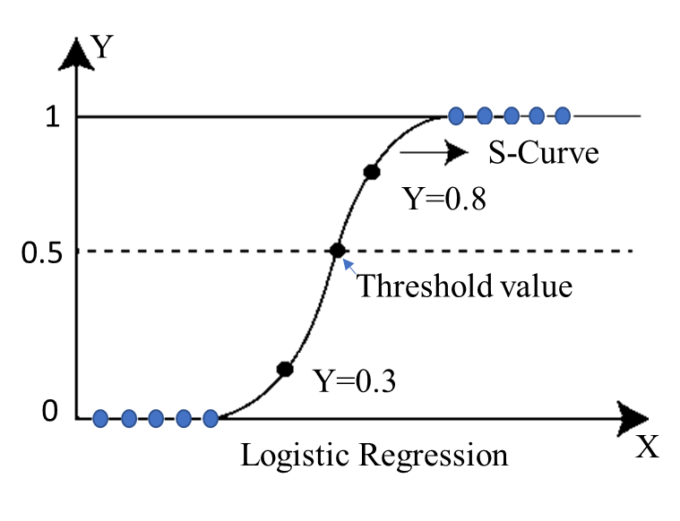
Algorithms
Figure 2. Logistic Regression Algorithm
Figure 3. RF classifier
Figure 4. Decision Tree classifier

Slide 8
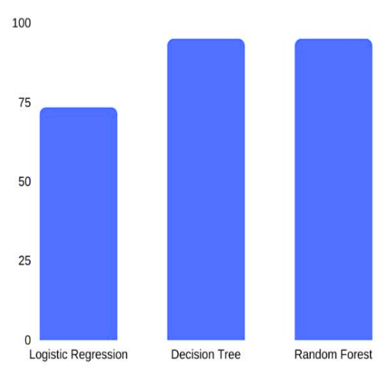
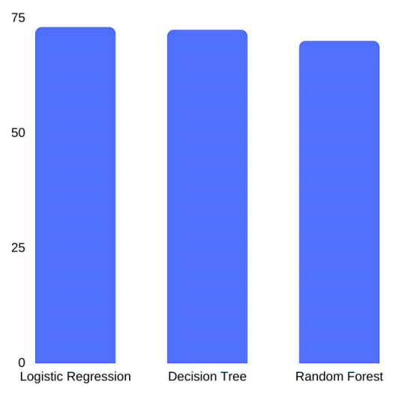
Figure 5. Training Acuracies of threee algorithms
Figure 6. Testing Acuracies of threee algorithms

Slide 9
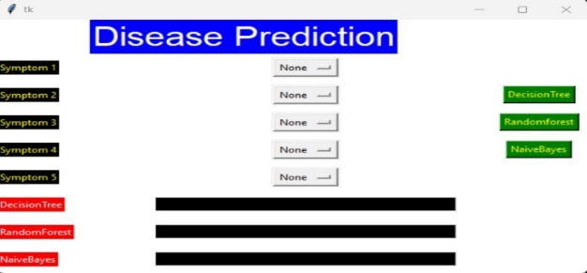
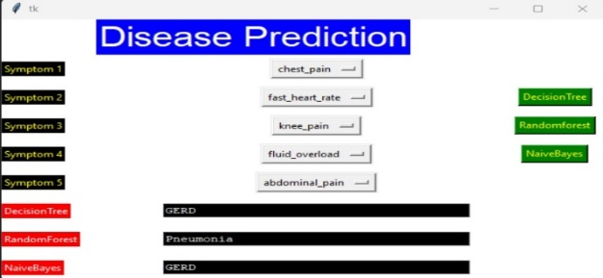
Figure 7. Interface of the model
Figure 8. Output of the model

Slide 10
Conclusion
This paper presented a smart health prediction using machine learning. GUI is developed for five symptoms with three algorithms such as decision tree, RF, and logistic regression. By leveraging this comprehensive approach, the system provides an efficient and effective means of diagnosing illnesses. By incorporating multiple algorithms, the system increases the accuracy of the diagnosis and enhances the overall reliability of the results. This advanced functionality ensures that patients receive accurate information about their condition, aiding in the provision of appropriate medical care and treatment. In future work, we adopt new deep learning techniques and compare with state of art models.

Slide 11
References
1.Tanveez, S., Amer, M. D., Vamshika, C., Reddy, A. S., Prasad, C. R., & Yalabaka, S. (2022, June). Facial Emotional Recognition System using Machine Learning. In 2022 2nd International Conference on Intelligent Technologies (CONIT) (pp. 1-4). IEEE.
2.Gankidi, N., Gundu, S., viqar Ahmed, M., Tanzeela, T., Prasad, C. R., & Yalabaka, S. (2022, June). Customer Segmentation Using Machine Learning. In 2022 2nd International Conference on Intelligent Technologies (CONIT) (pp. 1-5). IEEE.
3.Prasad, C. R., Arun, B., Amulya, S., Abboju, P., Kollem, S., & Yalabaka, S. (2023, January). Breast Cancer Classification using CNN with Transfer Learning Models. In 2023 International Conference for Advancement in Technology (ICONAT) (pp. 1-5). IEEE.
4.Narain, R., Saxena, S., & Goyal, A. K. (2016). Cardiovascular risk prediction: a comparative study of Framingham and quantum neural network-based approach. Patient preference and adherence, 1259-1270.
5.Patel, J. (2015). Prof. Tejal Upadhyay, Dr. Samir Patel, “. Heart disease prediction using Machine learning and Data Mining Technique, 7(1Sept), 2016.

Slide 12
THANK YOU

